Slide 1
Python Oops
Harshiv Bhatt (1015356)

Slide 2
Agenda
Basic class & object creation
Inheritance
Abstract class
Polymorphism
Class method & static method

Slide 3
Basic class definition
We all know the traditional definition of class and object.
Class is a template which contain set of attributes and methods. Main intention of creating class is we defined all the activity in one roof. Long project contain lots of file and lots of method to run whole software so at that time if we have defined this all the method and attributes under one environment then it is easily callable.
Now if we have a class then how can we run that particular class? So for that in the object oriented programming we create the instance of class which called the Object. Any object of that particular class can access all the attributes and methods.

Slide 4
Inheritance
When we want to derived the properties of another class at that time we need the concept of Inheritance.
Inheritance is a mechanism that allows a class to inherit properties from the base class. We can use that same method in our ,child class. Here base class or super class means The class from where we derived all the properties. And the child class means in which we reuse that all methods.
Inheritance allows developers to reuse code and create a hierarchical class structure. A subclass can inherit all the properties and methods of the superclass, and it can also add its own properties and methods or override the inherited ones.

Slide 5
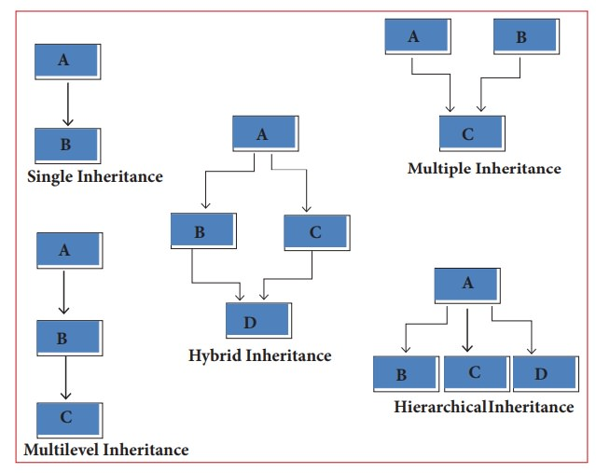
Types of Inheritance

Slide 6
Abstract class
An abstract class can be considered as a blueprint for other classes. It allows you to create a set of methods that must be created within any child classes built from the abstract class. A class which contains one or more abstract methods is called an abstract class.
An abstract method is a method that has a declaration but does not have an implementation.
For Abstract class we need to import ABC and abstractmethod in python environment.
We can’t use abstract class directly. We can’t create the object of abstract class. We need to create a object of child class in which we inherit the abstract class.

Slide 7
Why we use Abstract class
Abstract classes is to create templates for future classes
Abstract Classes offer the added benefit of letting you define the functionality that your child classes can utilize later
API

Slide 8
Polymorphism
Polymorphism is one of the fundamental concept of Oops.
Polymorphism refers to the ability of different objects to respond to the same message or method in different ways. In Python, polymorphism is achieved through method overriding and method overloading.
Method overriding occurs when a subclass provides its own implementation of a method that is already defined in its parent class. When a method is called on an object of the subclass, the subclass's implementation of the method is used instead of the parent class's implementation.

Slide 9
Class method & static method
Class method
Class methods are defined using the @classmethod decorator and take the class itself as the first arguments. (usually called cls)
class method is a method that is bound to the class and not the instance of the class. This means that the method can be called on the class itself, rather than on an object created from the class.

Slide 10
Continue…
Static method
Static methods are defined using the @staticmethod decorator and do not take any implicit first argument like instance ‘self’ or ‘cls’. This means that they can be called on the class itself, or on an object created from the class, without any difference in behavior.
static method is a method that belongs to a class and does not have access to the instance or class state. It is essentially just a regular function that is defined inside a class, but does not operate on any instance or class attributes.

Slide 11
Thank you

